Slide 1
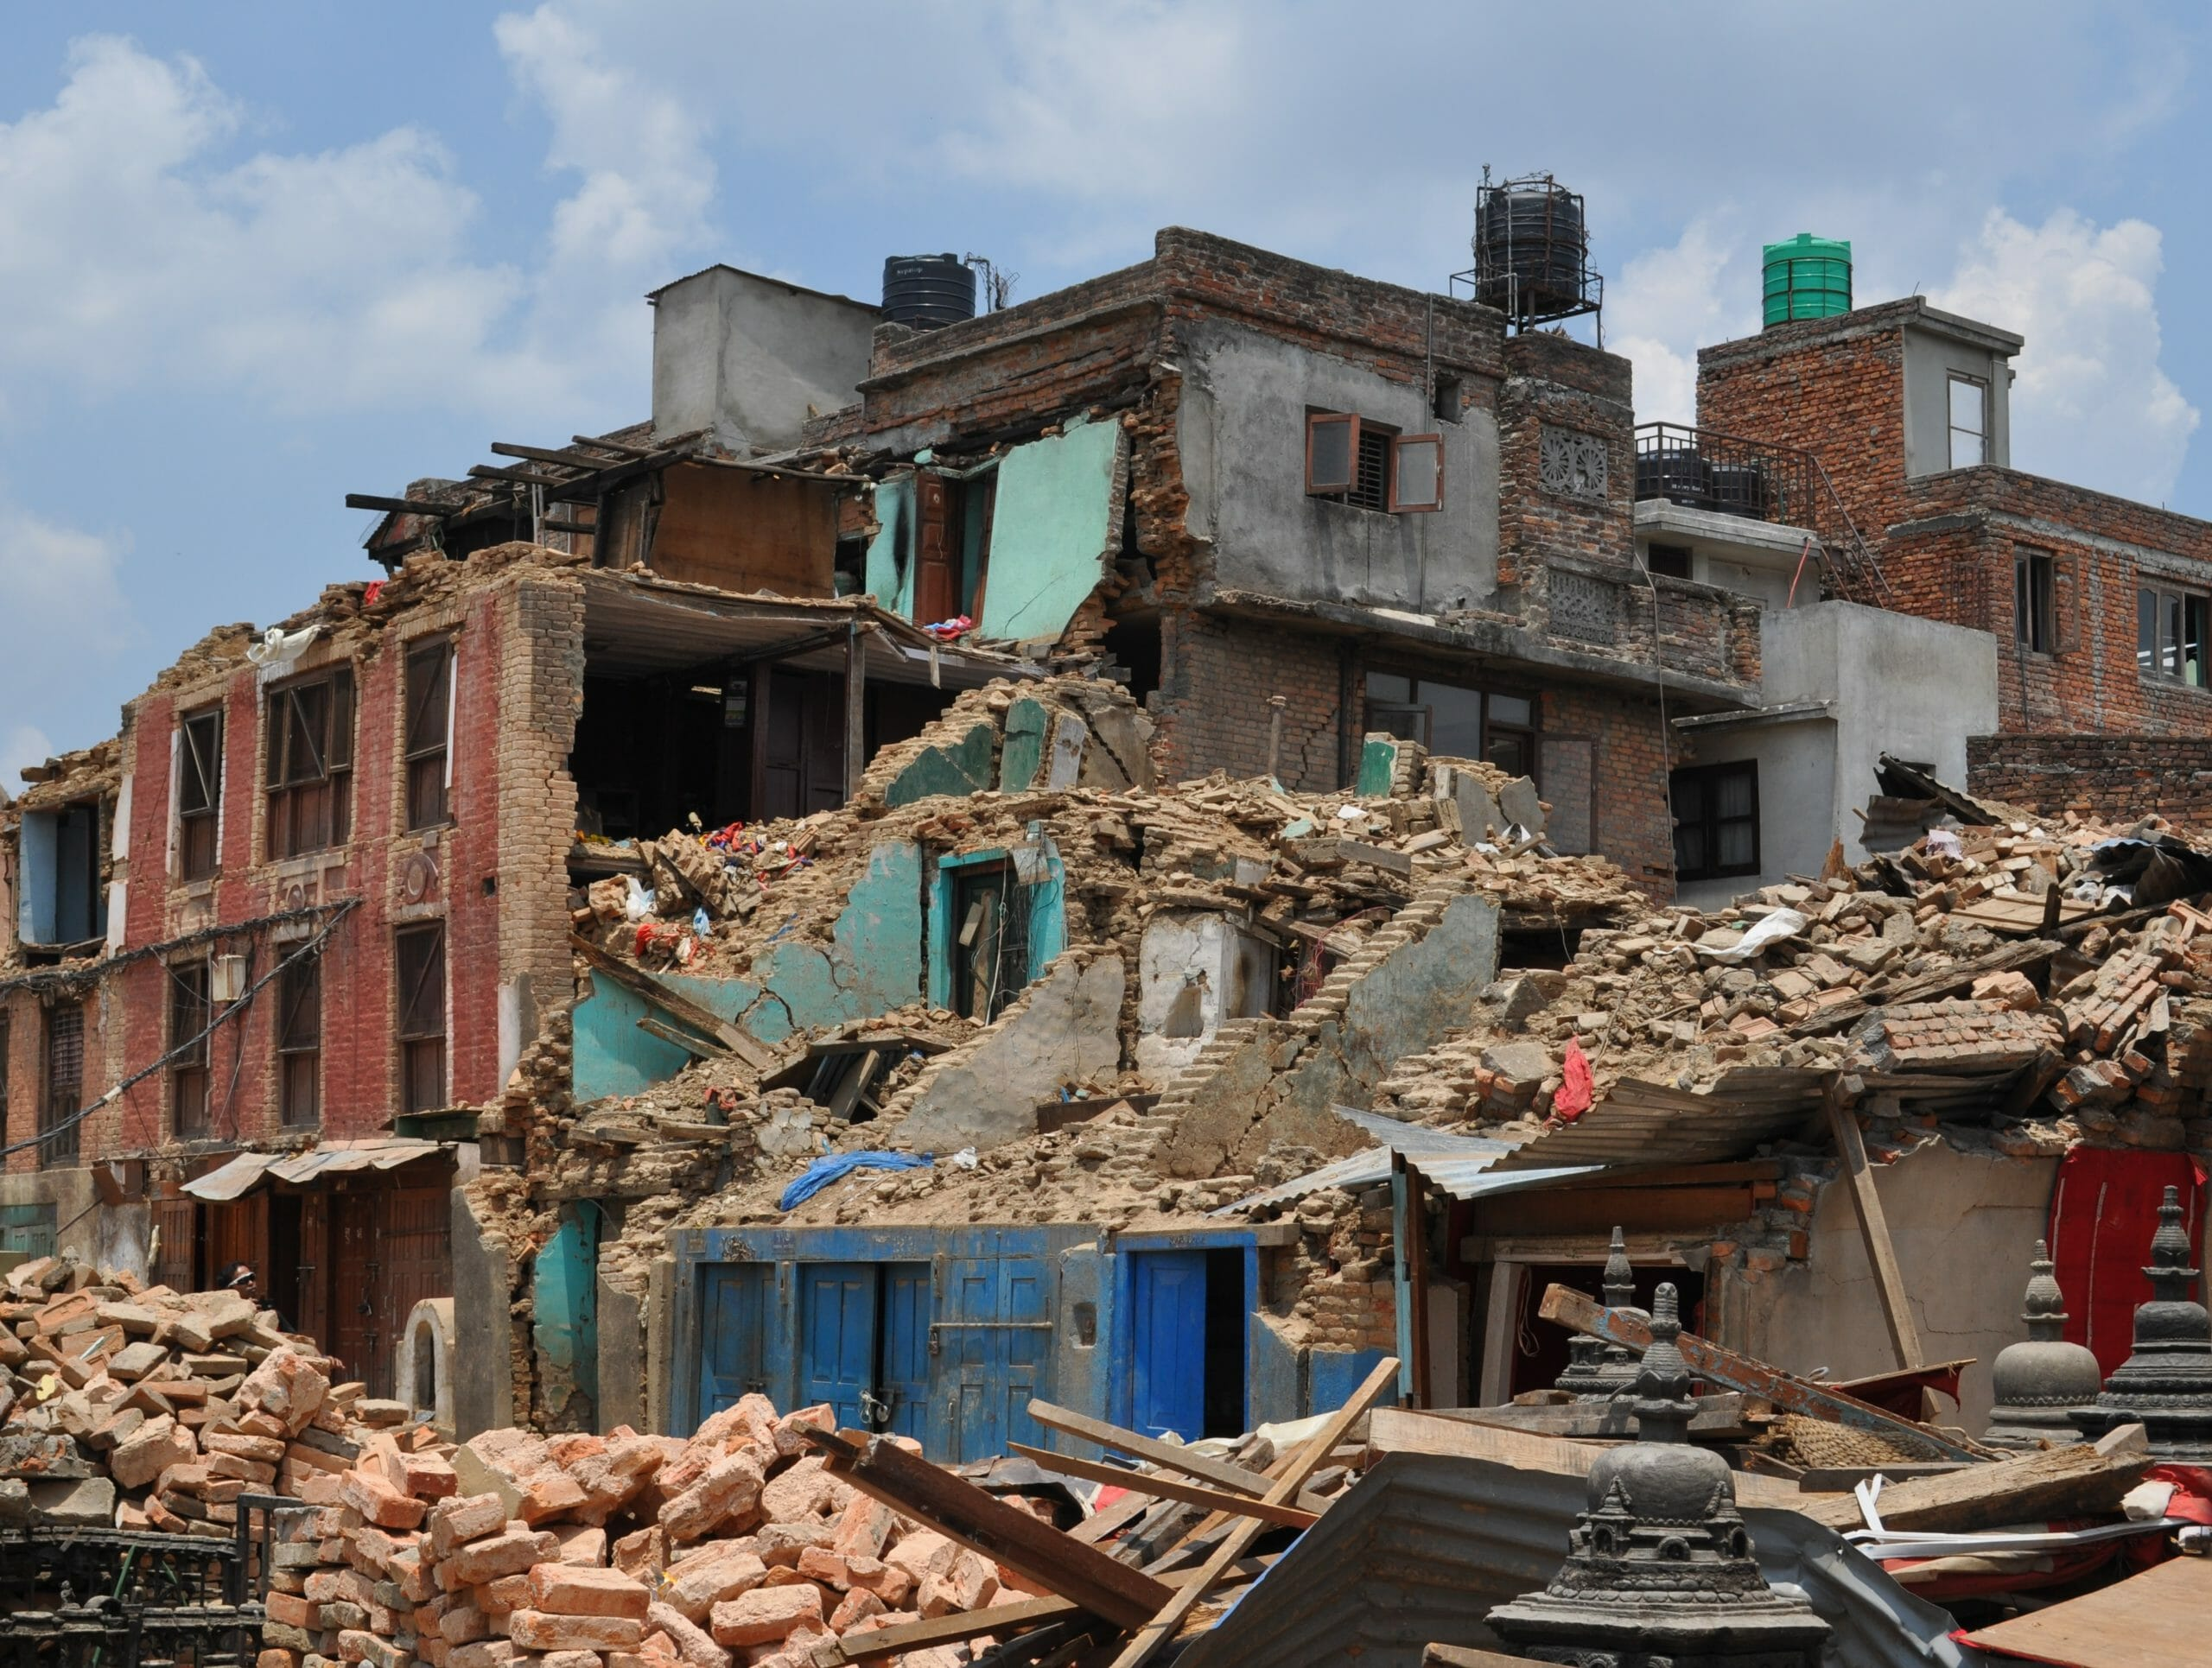
GORKHA EARTHQUAKE

Slide 2
Contents
Page
INTRODUCTION
MEASUREMENTS
EFFECTS
BACKGROUND
VIDEOS
End
3-6
7
8
9-10
11

Slide 3


INDRODUCTION TO EARTHQUAKE
Earth
Quake
Shake
or
Tremble

Slide 4
DEFINATION
A sudden violent shaking of the ground, typically causing great destruction, as a result of movements within the earth's crust or volcanic action.
The shaking is caused by movements in Earth’s outermost layer.

Slide 5
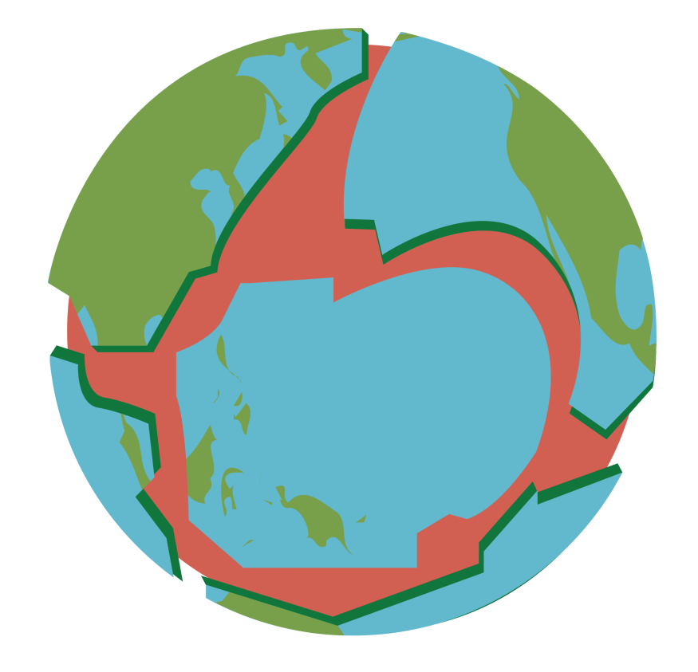
How Do Earthquakes Happen?
Earth is not just a one piece, it is made up of jigsaw puzzles of around 19 to 20 pieces which are called as tectonic plates.
These plates are placed on a hot partially molten layer of earth mantle. This is the reason why these pieces are continuously moving.
These plates move around 1 to 2 cm each year but not all these movements can be felt by us.
Sometime these vibration are extremely strong and can be felt like a lot of vibration under our feet. And it can also destroy a entire city.
Due to that extremely strong vibration earthquake occurs.

Slide 6
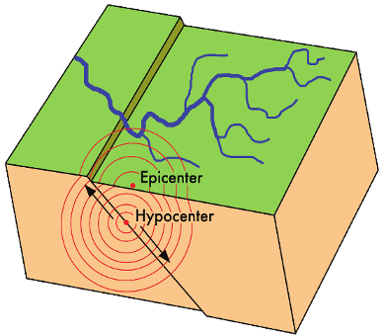
Hypocenter and Epicenter
Hypocenter:
The point at which the earthquake occurs under the earth is called Hypocenter.
Epicenter:
The exact place above the hypocenter at the surface of earth is called Epicenter.

Slide 7
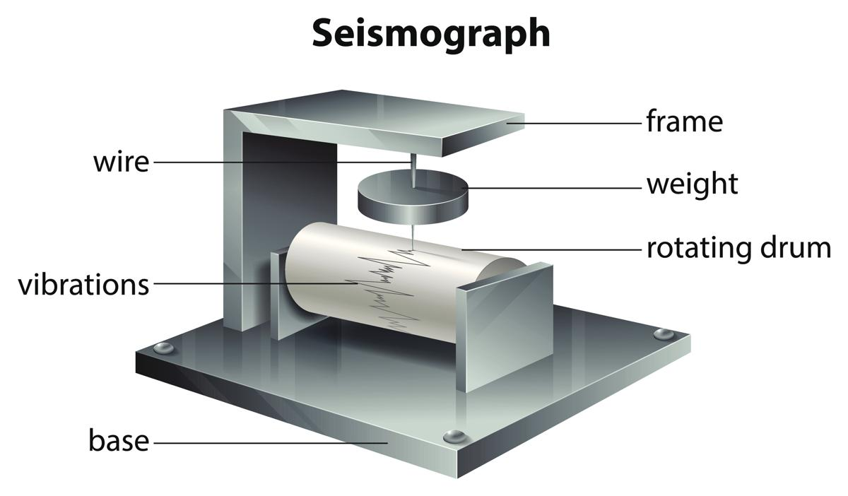
Measurement of Earthquake
Geologists use a device that can sense the waves created by the movement of the tectonic plates. These waves are known as seismic waves and the device is called a seismograph. This records the waves ranging from 0 – 10 where 0 is lowest, where people feel nothing and 10 being the highest that destroy continents. These are measured on the Richter scales.

Slide 8
EFFECTS OF EARTHQUAKE
Ground Shaking
Ground shaking is a term used to describe the vibration of the ground during an earthquake. Ground shaking is caused by body waves and surface waves.
Landslides
Past experience has shown that several types of landslides take place in conjunction with earthquakes. The most abundant types of earthquake induced landslides are rock falls and slides of rock fragments that form on steep slopes.
Tsunamis
Tsunami are water waves that are caused by sudden vertical movement of a large area of the sea floor during an undersea earthquake. Tsunamis are often called tidal waves, but this term is a misnomer.

Slide 9
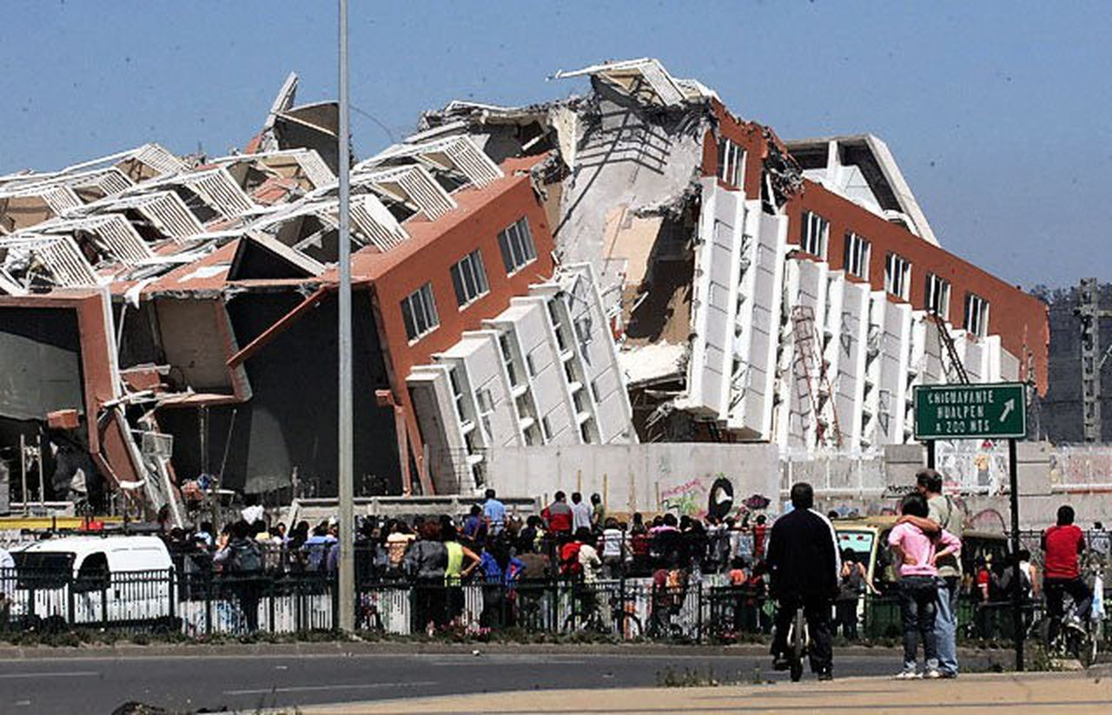
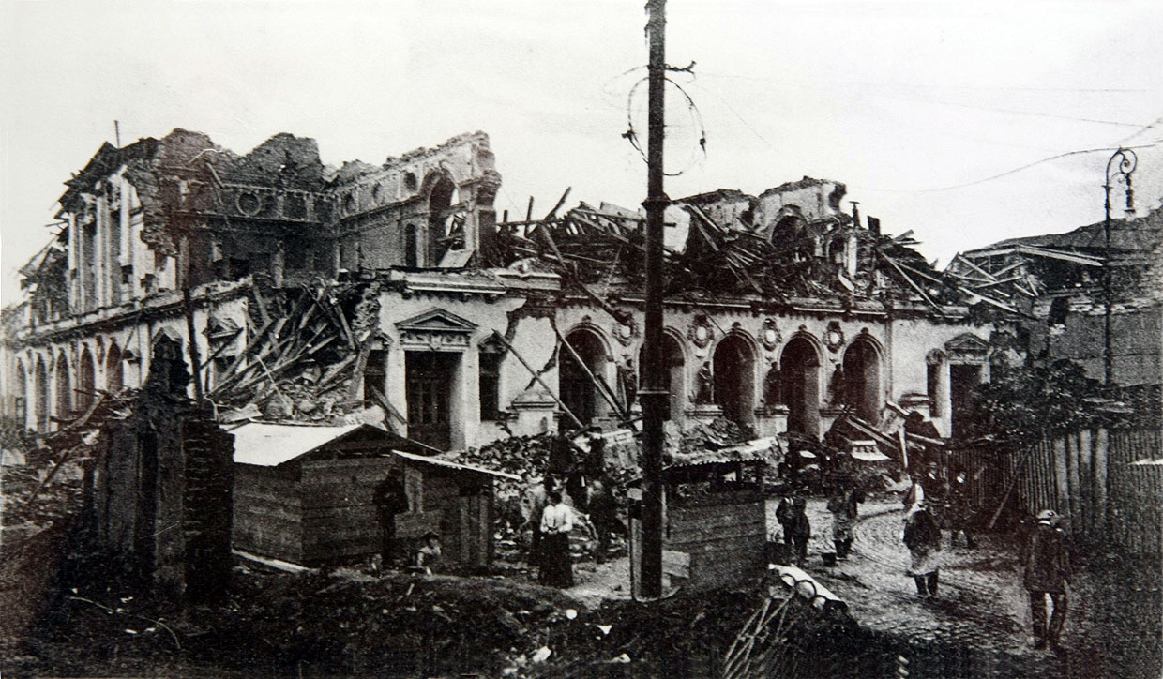
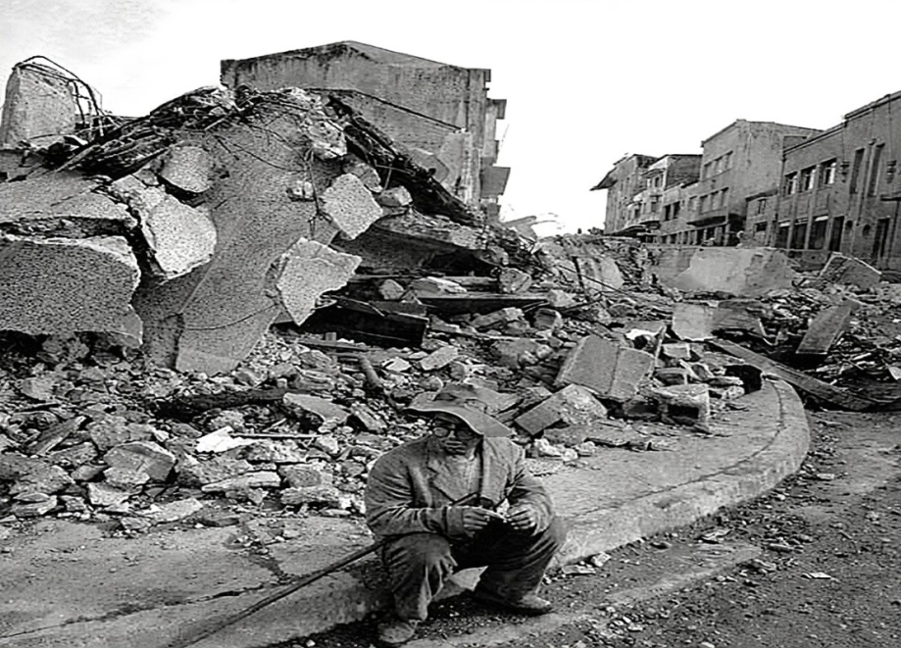
BACKGROUND OF EARTHQUAKE
The world's largest earthquake with an instrumentally documented magnitude occurred on May 22, 1960 near Valdivia, in southern Chile. It was assigned a magnitude of 9.5 by the United States Geological Survey.

Slide 10
Background of Gorkha Earthquake
The April 2015 Nepal earthquake (also known as the Gorkha earthquake) killed 8,964 people and injured 21,952 more. It occurred at 11:56 Nepal Standard Time on Saturday, 25 April 2015, with a magnitude of 7.8Mw. Its epicenter was east of Gorkha District at Barpak, Gorkha, roughly 85 km northwest of central Kathmandu, and its hypocenter was at a depth of approximately 8.2 km.

Slide 11
https://youtu.be/gjzuNXN0R78

Slide 12
Thank You

